Slide 1

www.egida-project.eu
1stJoint Workshop of the EGIDA Stakeholder Network and Advisory Board
Connecting GEOSS and its Stakeholders in Science and Technology
Bonn, Germany, May 9-11, 2011
EGIDA
Stakeholder Network and Advisory Board and Their Relevance for EGIDA and GEO
Stefano Nativi

Slide 2
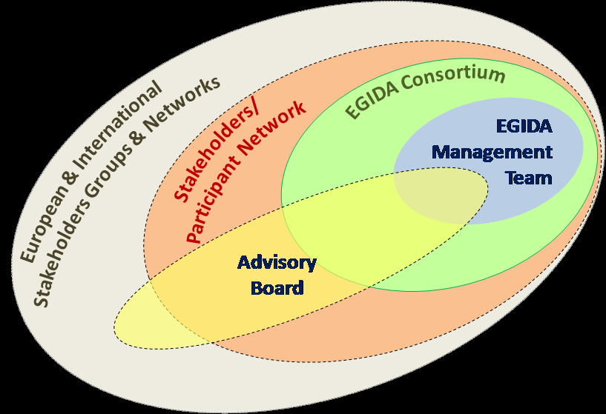
Rationale: Extended Consortium

Slide 3
Stakeholders network

Slide 4
Objectives
Provide a link between the EGIDA project and the broad European and international S&T community
Disseminate the project results to the S&T community
Enhance information exchange, knowledge creation, and sharing good practices
Provide the basis for the sustained continuation of the process for European engagement in GEOSS to be developed in EGIDA beyond the project lifetime

Slide 5
Approach and Function
Support EGIDA in the identification of relevant S&T communities not represented in the Stakeholder Network, and facilitate links to these communities
In co-ordination with EGIDA actively solicit contribution from European S&T communities that have been identified as essential but not yet available to GEOSS
Provide feedback to the EGIDA team with respect to the project progress and the processes for the linkage of S&T communities to GEOSS developed in the project
Contribute to the Activities detailed in the STC Road Map,
Contribute to ensure that GEOSS is built based on state-of-the-art science and technology
Contribute to the analysis phase and design of the EGIDA Methodology
Contribute to the EGIDA Methodology transfer and use cases development

Slide 6
Members
The Stakeholders Network is international in character and has participants from organizations beyond Europe
Composed of representatives of S&T institutions, teams, programs, and organizations already contributing or having the potential to contribute to GEOSS
Open to those contributing to the STC and the S&T Roadmap Tasks
Ensure representation of the other GEO components, including the ADC, CBC, and UIC
Particular emphasis on the inclusion of GEO Members from developing regions

Slide 7





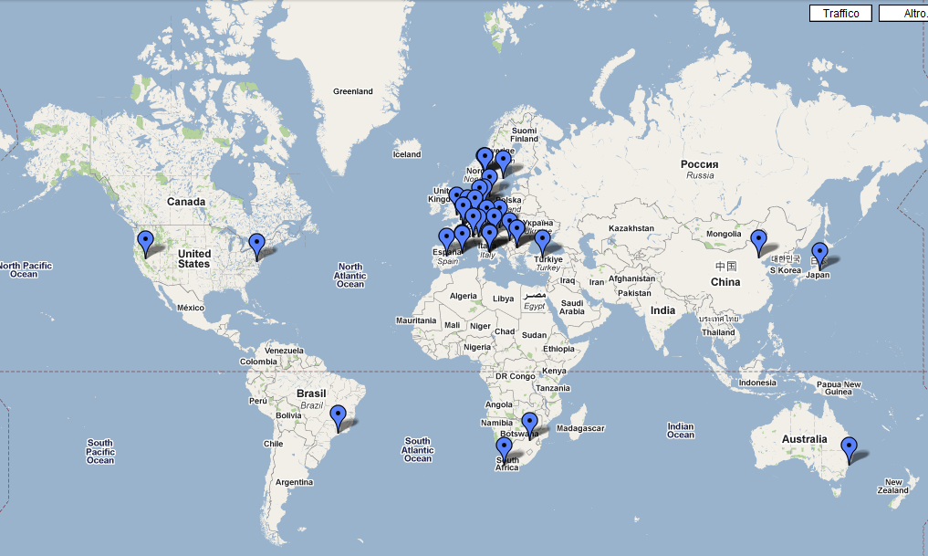
EGIDA Stakeholders

Slide 8
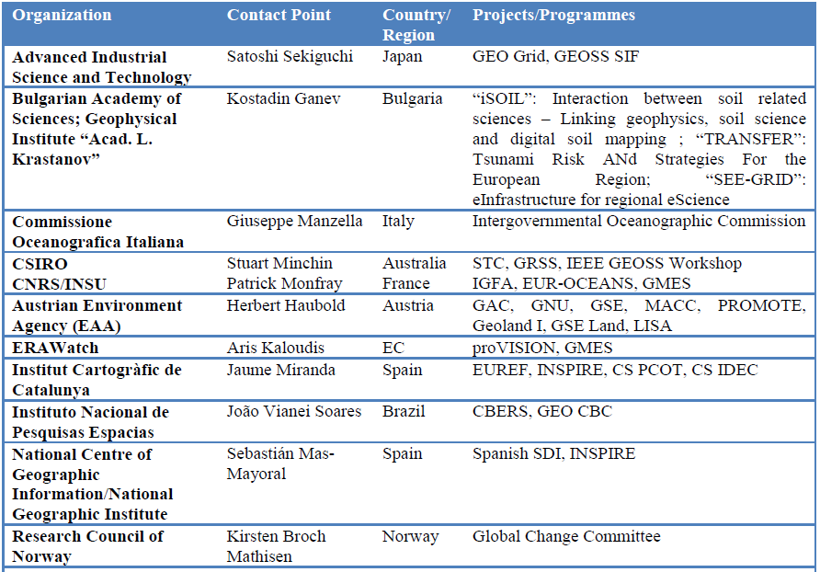
Stakeholders Network Members

Slide 9
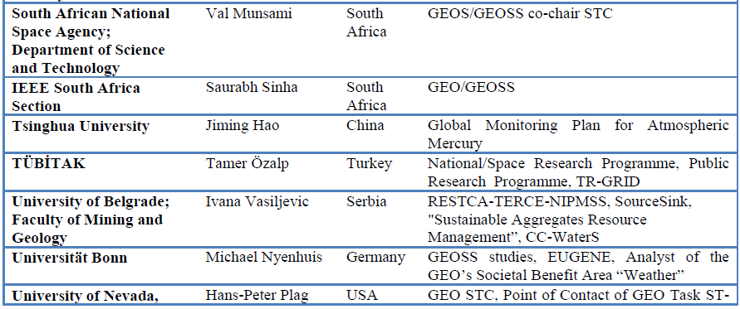
Stakeholders Network Members
New possible members are present here

Slide 10
Advisory Board

Slide 11
Objectives
Facilitate maximum benefits of the EGIDA Project for European Science and GEOSS and its users
Exploit synergies between the project activities and those of relevant European and international initiatives
Provide a mutual link between the EGIDA Project Consortium and the European and international research systems
Provide guidance from the perspective of these systems

Slide 12
Approach and Function
Provide valuable advice and guidance (based on the members experiences) focusing on S&T Community future plans and activities;
Provide valuable advice and guidance on EGIDA process sustainability to facilitate the continuation of the processes developed by the Project (to link European science with GEOSS) beyond the project lifetime
Review the project's deliverables received from the Project Consortium
Solicit feedback from stakeholders in the European and international research system concerning EGIDA's methodology, dissemination and outreach
The EGIDA Advisory Board will meet once a year

Slide 13
Members
Representatives of various actors in
  The global research system
  International science organizations
  National and European agencies
  Implementing organizations
  Policy makers and performers
  GEO/GEOSS implementation leaders
Selected National governmental and funding agencies
A special effort will be made to find a geographical balance and to include representation of actors from developing countries

Slide 14
Next Review action
D2.7: Process for communicating the scientific priorities in Earth observations (month 9)
D3.1: Proposal for a GEOSS citation standard (month 9)
D3.2: Proposal for a GEO Label (month 12)

Slide 15
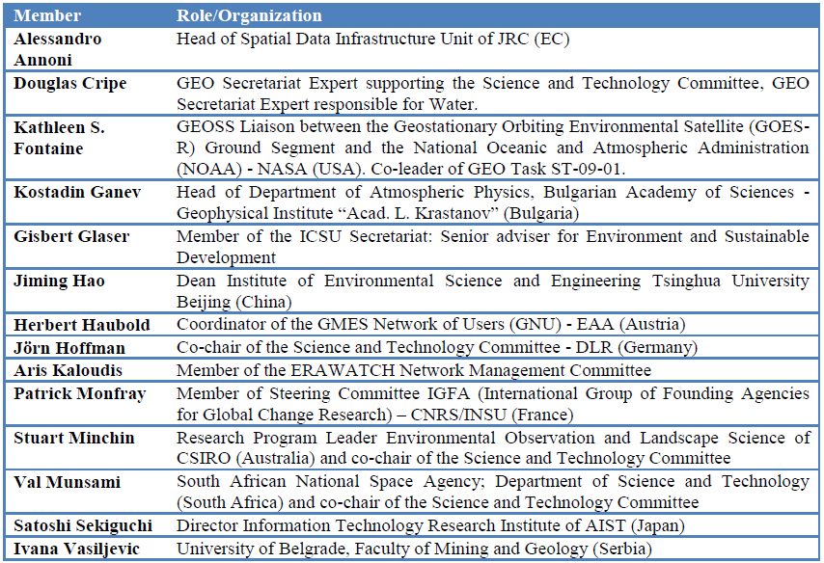
Advisory Board Members

Slide 16
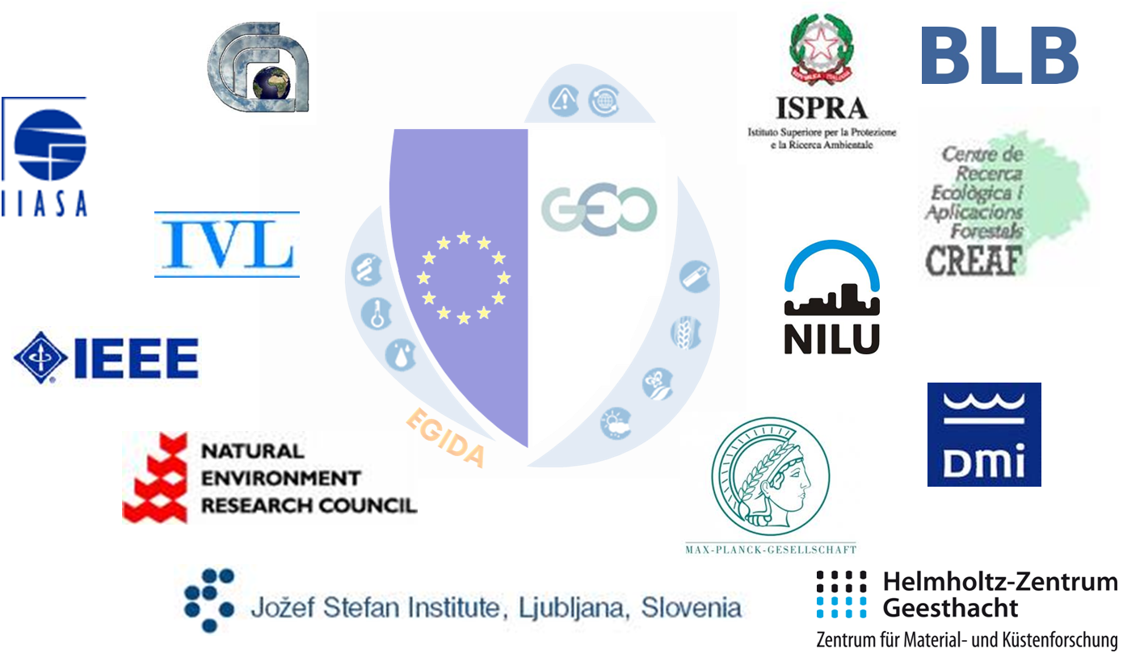
www.egida-project.eu

Slide 17
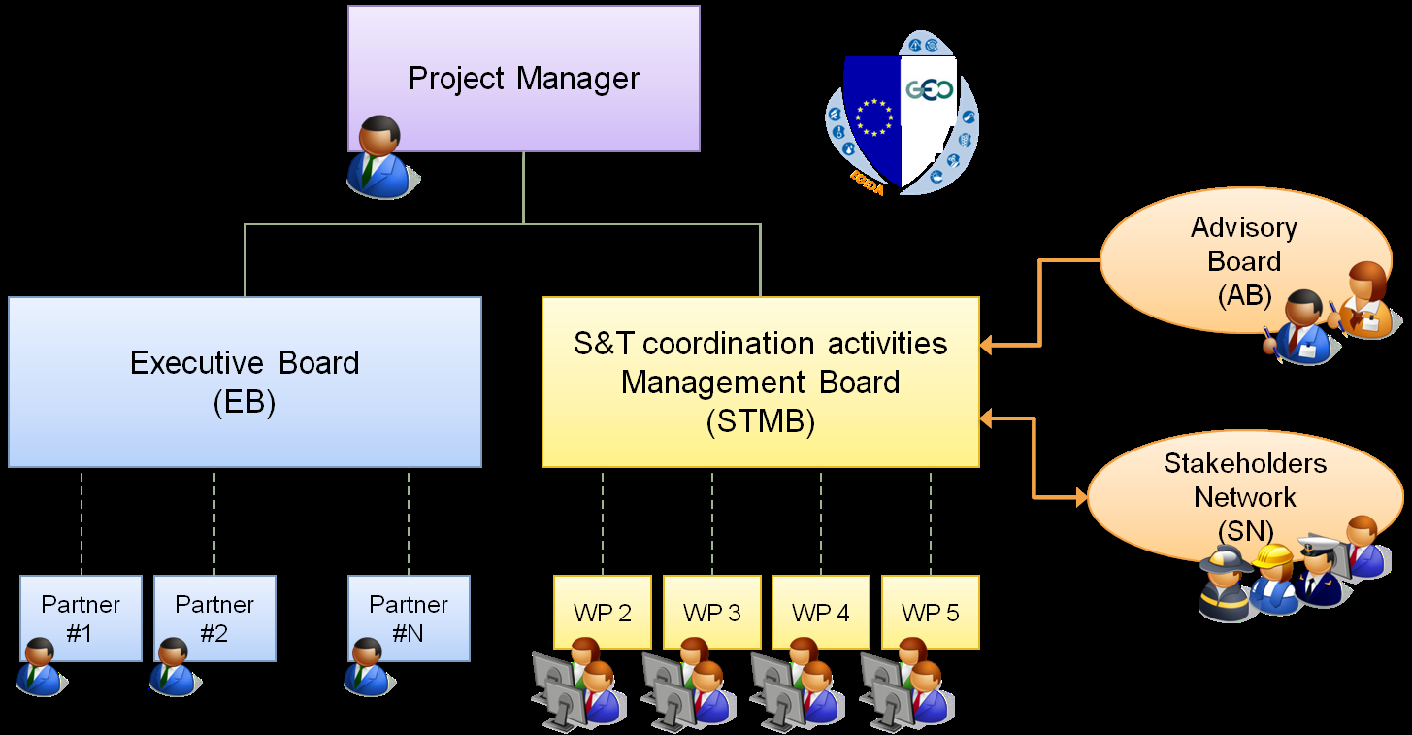
Rationale: Extended Concortium

Slide 18
SN Approach and Function
The members of the Stakeholder Network will
  participate in Workshops and other meetings of the EGIDA project as appropriate
  organize Stakeholder meetings in co-ordination with the EGIDA project and the STC
  establish communication channels within the Stakeholder network and to other relevant communities - with support from the EGIDA project

Slide 19
SN Organizational Structure
Chaired by at least three co-chairs –one of them being a member of the Project Consortium.
The other co-chairs will be determined by the Stakeholder Network
Two offered candidatures to serve as co-chairs
  Michael Nyenhuis (Univ. of Bonn, Analyst of the GEO‟s Societal Benefit Area “Weather”)
  Hans-Peter Plag (Univ. of Nevada – Reno, PoC GEO Task ST-09-02)

Slide 20
AB Organizational Structure
Chaired by at least two co-chairs –one of them being a non-European member
Chairs to be elected at the first face-to-face meeting

